Slide 1

Clustering
the Market
Navigating Market Dynamics
through Machine Learning
Hetansh Patel

Slide 2
Introduction
A brief look at what we will discuss on this report
Data Overview
Methodology
Data Preprocessing
Feature Engineering
Clustering Approach
Portfolio Optimization
Strategy Simulation
Results

Slide 3
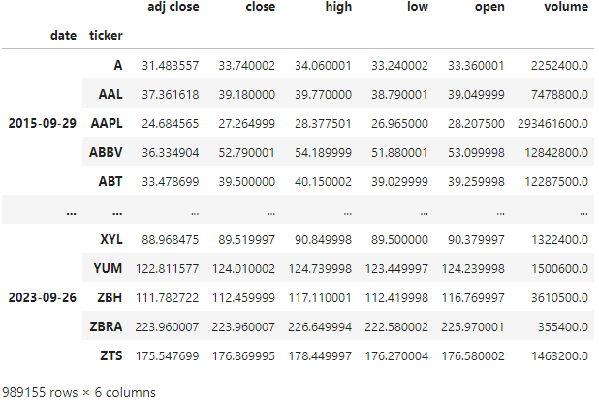
Data Overview
Source: Data was sourced from Yahoo Finance using Wikipidea and Fama-French databases, encompassing over a decade of daily stock price and trading volumes.
Scope: The dataset includes daily observations from 2015 to 2024, covering 500 stocks from the S&P 500 index.
Structure: Data is Structured in a panel format with a multi-index on date and tickers symbols, featuring columns for close, volume and other price metrics.

Slide 4
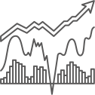
Methodology
Data Cleaning: Missing data points were identified and removed, ensuring robustness and accuracy in subsequent analyses.
Feature Calculation: Calculated technical indicators include Garman Klass Volatility, RSI, ATR, MACD, and Bollinger Bands, selected for their relevance in capturing market sentiment and volatility.
Stocks Selection: Selecting top 150 stocks having more volatility.
Cluster Analysis: Implemented K-Means clustering with initial centroids guided by target RSI values to segment stocks into groups with similar price behaviors.
Portfolio Construction: Applied the Efficient Frontier framework to derive optimal asset weights for the portfolio, aiming to maximize Sharpe Ratio.

Slide 5
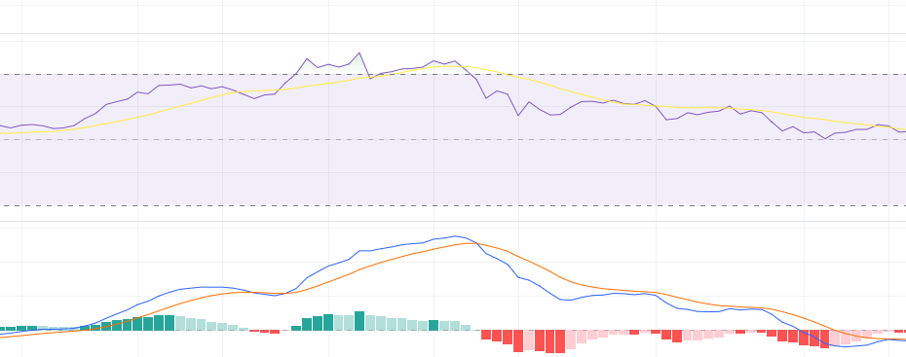
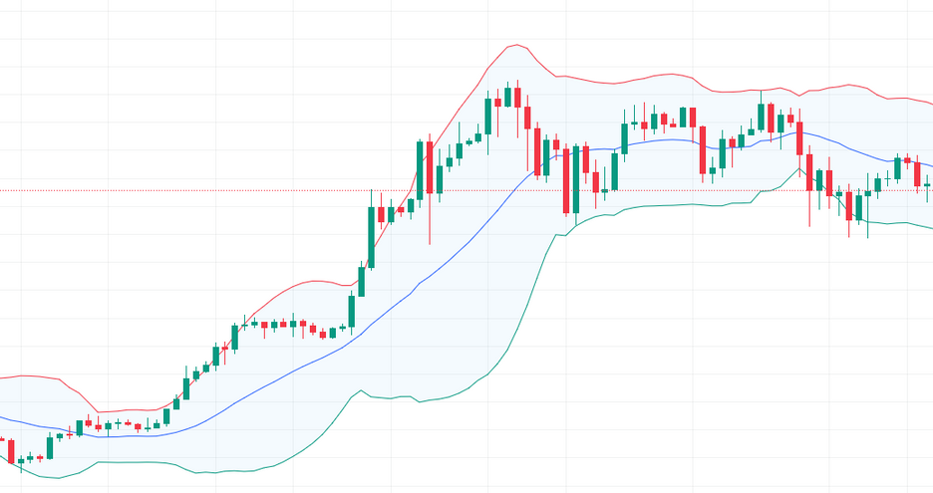
Feature Engineering
Garman Klass Volatility
Relative Strength Index
Average True Range
Moving Average Convergence Divergence
Bollinger Bands
Volatility bands around a moving average, indicating overbought or oversold conditions and potential price reversal.
Improved measure of volatility, considers open, high, low, and close prices.
Momentum oscillator, measures speed and change of price movements.
Measures market volatility by accounting for price gaps, giving a more accurate range.
Momentum indicator, compares two moving averages to identify trend strength and direction.

Slide 6
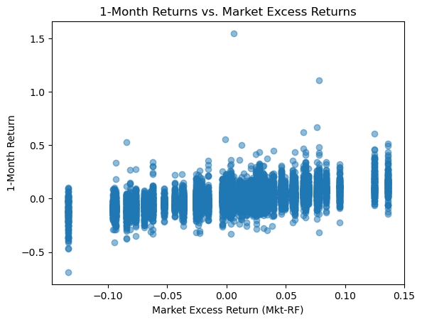
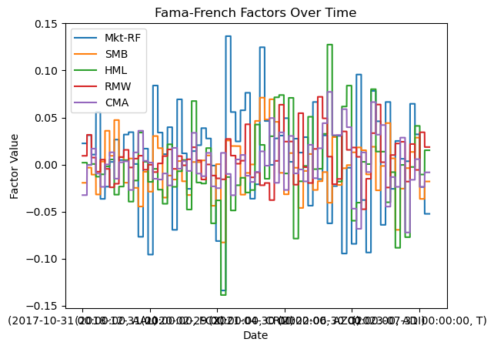
Fama And French
Market Risk
Small Minus Big
High Minus Low
Robust Minus Weak
Conservative Minus Aggressive
Excess market returns over risk-free rate.
Excess returns of small-cap stocks over large-cap stocks.
Excess returns of value stocks over growth stocks.
Excess returns of high profitability firms over low profitability firms.
Excess returns of conservative investment firms over aggressive investment firms.

Slide 7
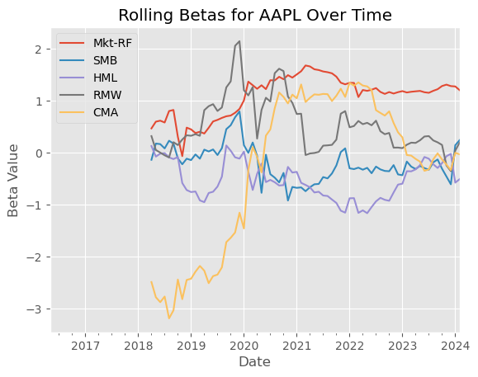
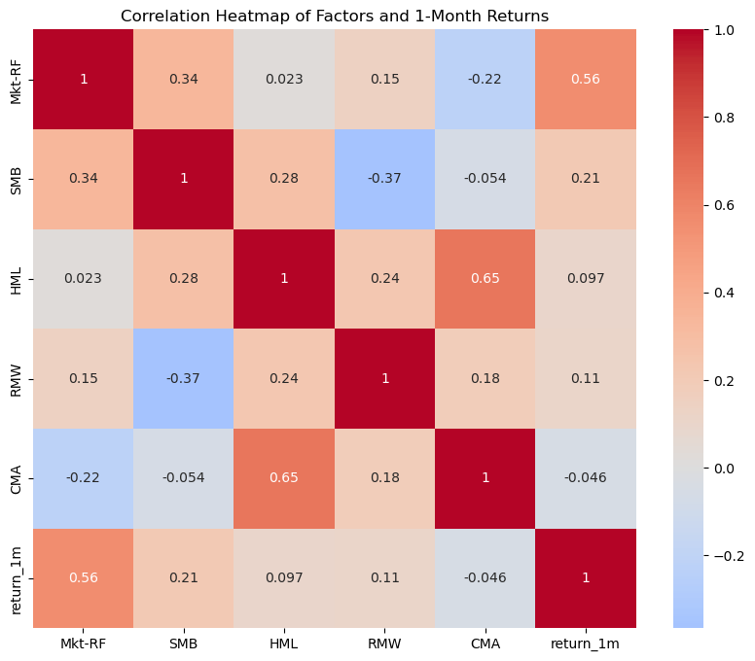
No correlation between this features

Slide 8
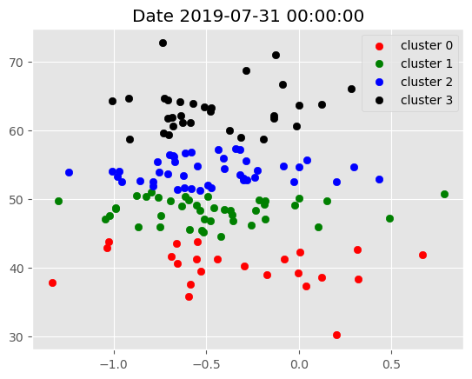
Clustering Analysis
Per Day
IMPLEMENTED K-MEANS CLUSTERING WITH INITIAL CENTROIDS GUIDED BY TARGET RSI VALUES TO SEGMENT STOCKS INTO GROUPS WITH SIMILAR PRICE BEHAVIORS

Slide 9
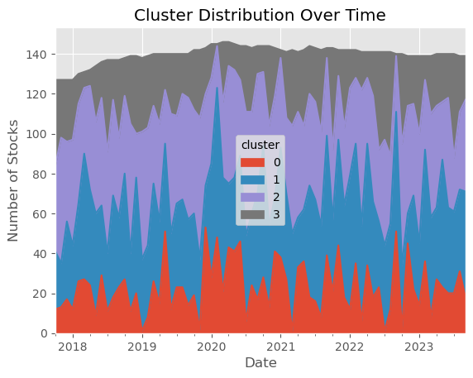
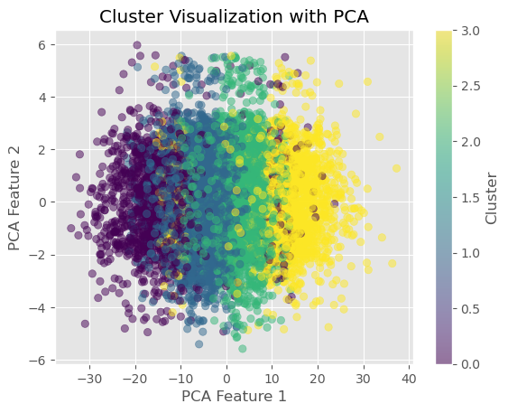
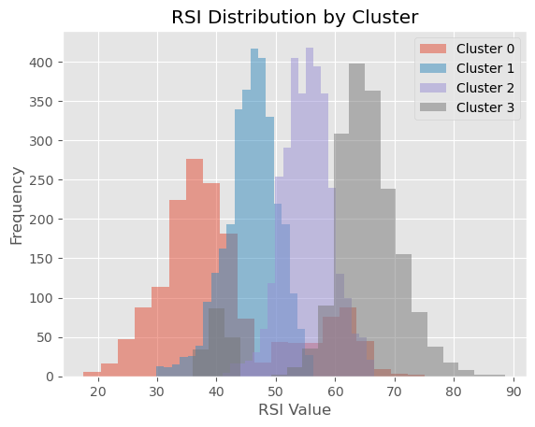

Slide 10
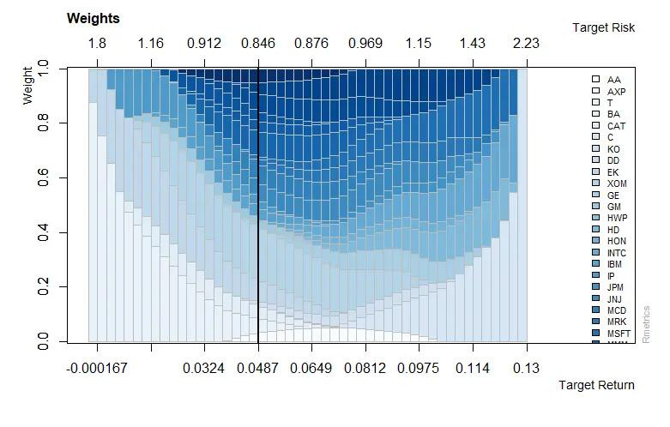
Portfolio Construction
Applied the efficient frontier framework to derive optimal asset weights for the porfolio, aiming to maximize sharpe ratio.

Slide 11
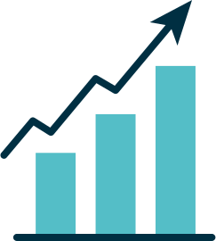
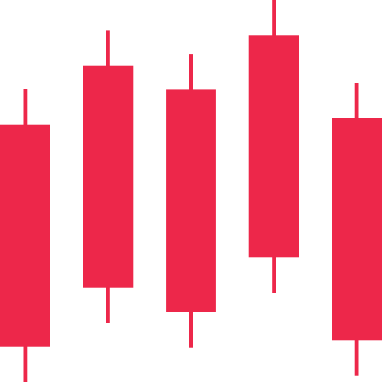
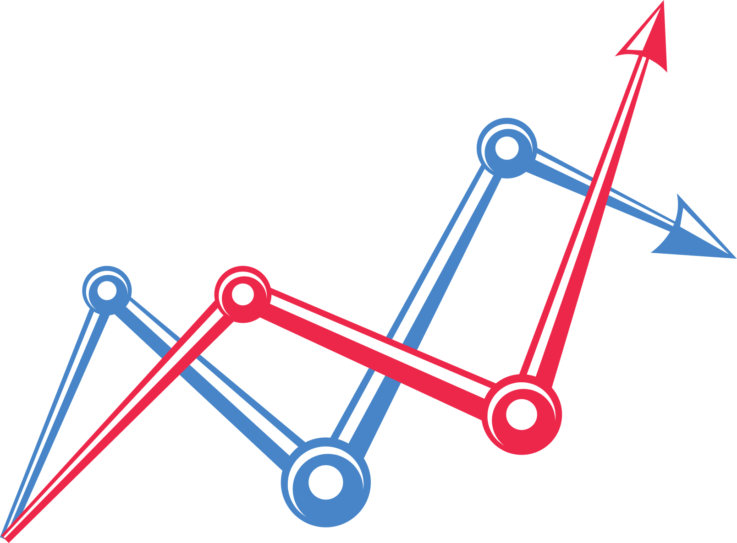
Portfolio Construction
1
3
Calculate daily returns for each stock which could land up in our portfolio.
If the maximum sharpe ratio optimization fails for a given month, apply equally-weighted weights.
2
Then loop over each month start, select the stocks for the month and calculate their weights for the next month.

Slide 12
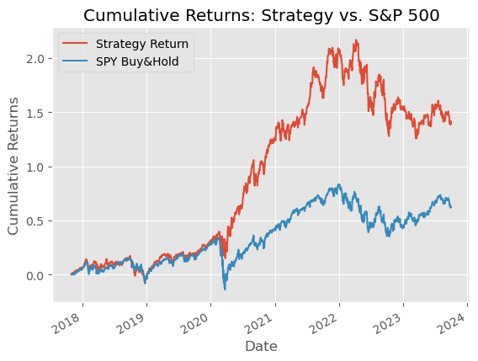
Portfolio Results
Initially both strategy and the s&p 500 track closely, but starting in 2019, the strategy outperforms, indicating it was able to take advantage of market conditions better than the passive index approach.
However, post-2022, there’s a significant drop in the strategy’s performance, while the S&P 500 shows less decline, which might indicate that the strategy took on more risk or was less effective during market downturns.

Slide 13
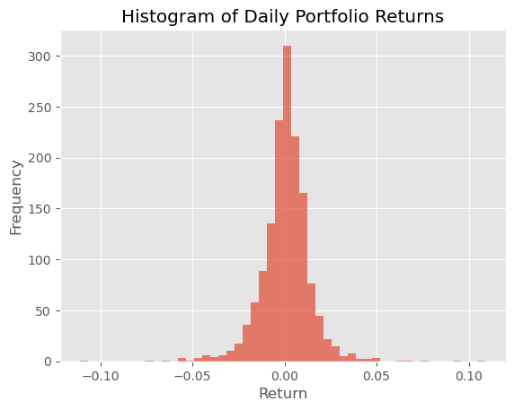
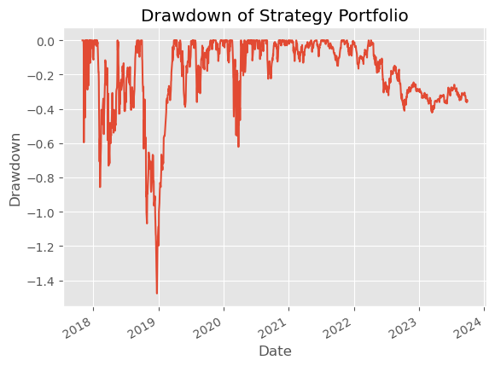
Return Distribution: This histogram displays the frequency distribution of daily portfolio returns, centering around zero, suggesting that most daily returns are close to no change.
Normality and Outliers: The shape of the distribution indicates the normality of returns; it also helps identify outliers, which are returns far from the mean, indicative of high-risk days.
Reduction in Portfolio Value: This chart illustrates the depth and duration of drawdowns, or declines from previous highs, in the strategy's portfolio value over time, with significant drawdowns visible in 2020 and 2023.
Risk Assessment: The drawdown plot is an important risk assessment tool, highlighting periods where the strategy underperformed and the potential impact on investors if assets were sold at low points.

Slide 14


Do you have any questions?

